Slide 1
MCB Case Study – Engineering Lead (Data) – Part 2
Nirantar Seewooruttun - 25th Nov 2021

Slide 2
Contents
Case study
Key stakeholders
Challenges
Gaps and Improvement Areas
Azure Devops
Team management
Q&A

Slide 3
Case study
The demand for data is growing in the bank for a range of use cases spanning from business intelligence, advanced analytics to regulatory reporting. There is thus a need to continuously improve the technology, processes and also the way enhancements are delivered (DevOps) so that the above use cases built on the enterprise data warehouse can scale without compromising on quality standards and time to market. However, the engineering improvements have been hard to implement due to a heavy backlog and this is not expected to decrease soon.

Slide 4
Key stakeholders
Operational line management – Loans / Credit risk / Individual and Corporate
Credit risk assessment team
Regulatory control reports to financial bodies
Data / Reporting / Analytics teams

Slide 5
Challenges
Backlog can occur due to multiple reasons including :
Growing reporting and analytics demand due to changing business situations. E.g COVID. Because of low business performance, there is an urgency of improving existing areas or find new business opportunities.
Limited staff availability (shared responsibilities) and / or employee attrition and brain drain
IT Methodologies → IT methodologies used to service the Bank’s requirements v/s Time to Market
Deployment practices → Manual

Slide 6
Gaps and Improvement areas
Gaps / Improvement areas:
Source code control / Deployment
Development plans and blueprinting.
Code documentation and testing practices.

Slide 7
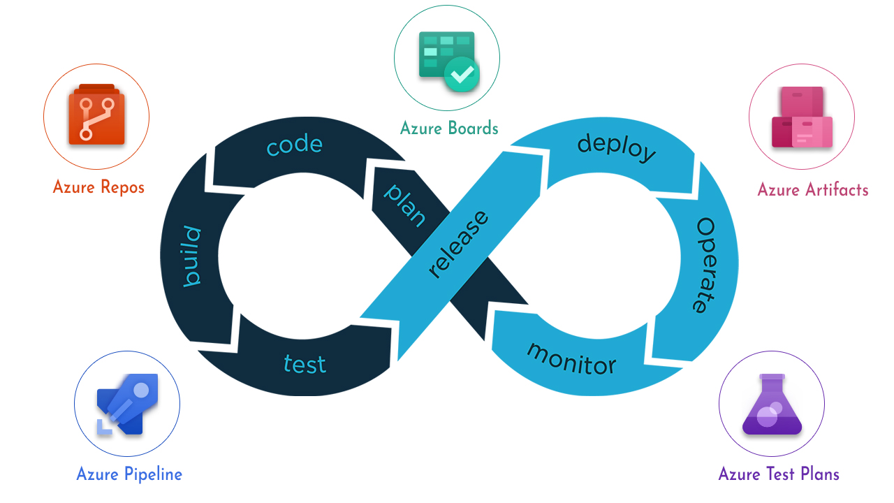
Azure Devops

Slide 8

Team Management

Slide 9
Questions
Q&A

